Slide 1

Bangladesh Army University of Engineering & Technology
Department of Computer Science and Engineering
EEE 2261: Electrical Drives and Instrumentation
Winter 2025 Semester
Lecture-08
Course Teacher
S. M. Ashik Al Mashrafi
Lecturer, EEE, BAUET
Total Credit: 3.0 Credit Taking: 3.0

Slide 2
Course Content
Chapter | Topics
Introduction | Three phase circuits, alternators and transformers, principles & operation of DC Machines, synchronous, induction, universal and stepper motors, thyristor and microprocessor-based speed control of motors
Instrumentation Amplifiers | Differential, logarithmic, and chopper amplifiers, frequency and voltage measurements using digital techniques, recorders and display devices, spectrum analyzers and logic analyzers, data acquisition and interfacing to microprocessor-based systems;
Transducers | Terminology, types of transducers, principles and applications of photovoltaic, piezoelectric, thermoelectric, variable resistance and opto-electronics transducers. Noise reduction in instrumentation

Slide 3
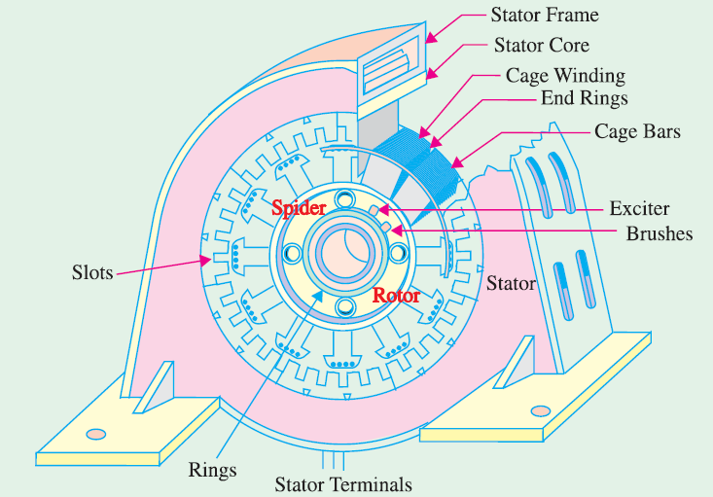
Alternator
An alternator is an electrical machine that converts mechanical energy into electrical energy in the form of alternating current (AC).
It operates on the principle of electromagnetic induction, where an electromotive force (EMF) is induced in a conductor when it cuts magnetic flux.
Fig. 1: Alternator.

Slide 4
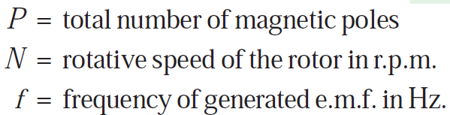
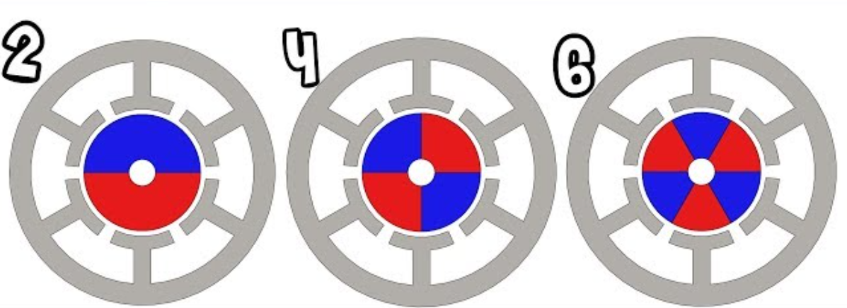
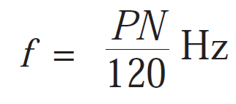
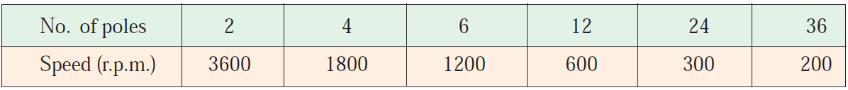
Speed and Frequency
Fig. 1: Pole number.
Example: f=60Hz

Slide 5
Factors Affecting Alternator Size
xxx

Slide 6
Voltage Regulation
xxx

Slide 7
Thank You
For Your Attention

